Slide 1

Stream & Batch processing with Apache Flink™
Asterios Katsifodimos
TU Berlin
asterios.katsifodimos@tu-berlin.de

Slide 2
Overview of the Tutorial
Introduction
API’s Overview
While we are giving the talks:
Grab one USB Stick
Install Java and IntelliJ
Start IntelliJ
Extract and import the project (code/Template.zip)

Slide 3
A (narrow) view of the Big Data Zoo
SQL
HiveQL
PigLatin
…
”Native” job (Java, Scala, C++…)
High Level Language Compiler
Get/Put Operations
Apache Flink
Apache Kafka
Apache Hadoop
Read/Write Bytes
Key/value Store
Hadoop Distributed File System (HDFS)
Cluster Management (Mesos, YARN, ZooKeeper…)

Slide 4
In this talk
Apache Flink Primer
Architecture
Execution Engine
API Examples
Stream Processing with Apache Flink
Flexible Windows/Stream Discretization
Exactly-once Processing & Fault Tolerance
The Road Ahead
The Emma language
Notes:
In this talk I am going to reverse the panel question from
“Can big data analytics tools perform real-time analytics” to
“Can real-time analytics tools perform Big Data processing”
To this end, I am going to give you an overview of the Apache Flink system and then drill down to some details on how stream procesing with Flink works, focusing on windowing and fault tolerance.
These two aspects are, for me, the two most important that have to be discussed.

Slide 5
Apache Flink Primer

Slide 6
What is Flink?
A platform for distributed batch and streaming analytics
Streaming dataflow runtime
Notes:
Flink is a stream processor that executes programs expressed in DAGs that can do a lot of things. To give you some examples.

Slide 7





Flink in the Analytics Ecosystem
Hive
Cascading
Giraph
Applications & Languages
Mahout
Pig
Crunch
MapReduce
Flink
Data processing engines
Spark
Storm
Tez
App and resource management
Yarn
Mesos
HDFS
HBase
Kafka
…
Storage, streams
7
Notes:
If we were to place Flink in an analytics ecosystem, then it would best fit among data processing engines, like MapReduce, Spark, Storm and Tez.

Slide 8


Where in my cluster does Flink fit?
Gathering
Integration
Analysis
Server
logs
Upstream
systems
Trxn
logs
Sensor
logs
Gather and backup streams
Offer streams for consumption
Provide stream recovery
Analyze and correlate streams
Create derived streams and state
Provide these to upstream systems
Notes:
What are the technologies that enable streaming? We need to gather, integrate/store and analyze streams.
One architecture that includes Flink is hown here: the data is gathered, integrated and stored in Kafka. Then Flink reads the stream and performs high level data analysis.
Kafka and Flink combined can remove the batch barriers from the infrastructure, creating a truly real-time analytics platform.

Slide 9
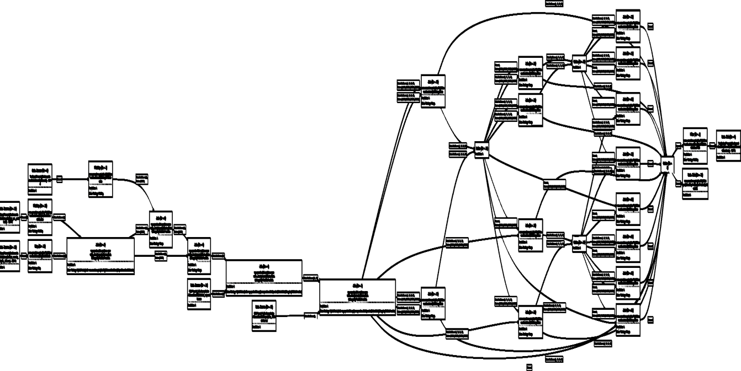
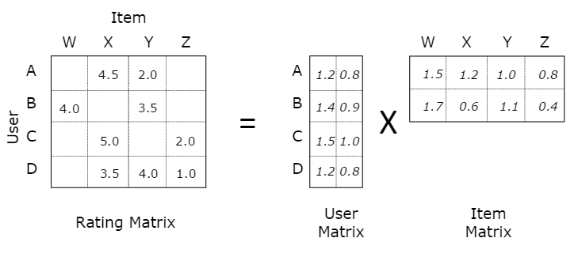
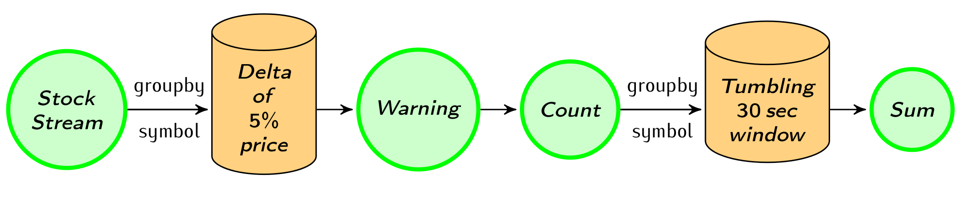
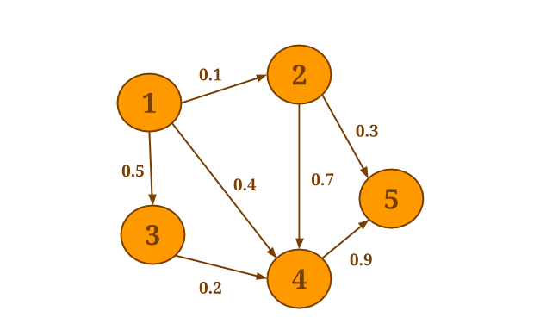
What can I do with it?
Batch
processing
Machine Learning at scale
Stream
processing
Graph Analysis
Flink
An engine that can natively support all these workloads.
Notes:
Flink can do stream processing, batch processing (as a special case of streaming), machine learning and graph analysis with the support for stateful iterations. How does it do all these?

Slide 10
Execution Model
Flink program = DAG* of operators and intermediate streams
Operator = computation + state
Intermediate streams = logical stream of records
SRC1
IS1
OP1
IS3
SNK1
Stateful Operator
Materialized Intermediate Data Stream (blocking data exchange)
SRC2
IS2
SNK2
Control Event
Data Record
Transient Intermediate Data Stream (pipelined data exchange)
Operator State
Notes:
Flink’s execution model, is a dag of operators and intermediate results.
Operators represent: Computation + State (map, join, etc.) and
Intermediate Results represent logical streams of records.
Some systems (like storm, etc.) have the operator+state at the heart of the execution model, while others (batch systems) operate around intermediate results (e.g., RDDs in Spark). Flink follows an approach where both operators and intermediate results are first class citizens. This enables Flink to do both stream and batch processing without sacrificing performance.

Slide 11
Architecture
Hybrid MapReduce and MPP database runtime
Pipelined/Streaming engine
Complete DAG deployed
Worker 1
Worker 2
Job Manager
Worker 3
Worker 4
Notes:
Flink takes the DAG that I showed you earlier and transforms it into a parallel execution plan that it can deploy.
The architecture is quite familiar to everybody: there’s a job manager that receives the job, and deploys it on a set of workers.
The execution plan that is created is pipelined: once an operator emits tuples/records, they do not need to be materialized but can be forwarded to the upstream operator.
As I stated before, all the operators of the execution plan are deployed in the cluster at once. Those operators are persisting and stateful: they stay deployed even in iterative plans.
For more details on iterations, please come to the BOSS workshop presentation.

Slide 12
Managed Memory
Language APIs automatically converts objects to tuples
Tuples mapped to pages/buffers of bytes
Operators can work on pages/buffers
Full control over memory, out-of-core enabled
Operators (e.g., Hybrid Hash Join) address individual fields (not deserialize object): robust
Tuple3<Integer, Double, Person>
IntSerialized
F0: int
DoubleSerialized
F1: double
Pojo (header)
Person
IntSerialized
Id: int
StringSerialized
Name: String
public class Person {int id; String name;}
4b
8b
1b
4b
Variable Length
Notes:
Flink is implemented in Java and runs on the JVM. We inherit all problems that come with garbage collection and massive maounts of objects.
The example that I showed before, used objects (e.g., the word String and the Count integer). Flink, through type inference can flatten objects into tuples and store them in memory pages.
Memory pages are used by operators (e.g., hybrid hash join) to perform all operations, since, a natural join only needs to compare two tuples for equality (through hashing). Idem for filters. Since Flink knows the size of every filed of a tuple, it can simply calculate the address of a field and refer to it in the respective memory page. Nothing new from that point: parallel databases.
The advantages:
1. alleviates the stress from the garbage collector that does not need to touch anything that is contained in the managed memory: everything is a byte buffer.
2. Spilling becomes more efficient and processing becomes very, very robust.
To show you an example: next slide.

Slide 13
Stream Processing with Flink

Slide 14
Ingredients of a Streaming System
Streaming Execution Engine
Windowing (a.k.a Discretization)
Fault Tolerance
High Level Programming API (or language)

Slide 15
Ingredients of a Streaming System
Streaming Execution Engine
Windowing (a.k.a Discertization)
Fault Tolerance
High Level Programming API (or language)

Slide 16
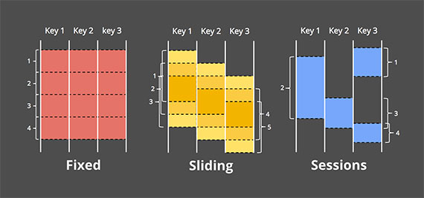
Stream Discretization
Data is unbounded
Interested in a (recent) part of it e.g. last 10 days
Most common windows around: time, and count
Mostly in sliding, fixed, and tumbling forms
Need for data-driven window definitions
e.g., user sessions (periods of user activity followed by inactivity), price changes, etc.
The world beyond batch: Streaming 101, Tyler Akidau https://beta.oreilly.com/ideas/the-world-beyond-batch-streaming-101
Great read!
Notes:
Not only with time, but also with event time, count, delta or anything else that is application specific.
We want to push as much of the application logic inside the platform where we can optimize.
Mini-batches will not cut it!

Slide 17
Flink’s Discretization
Allows very flexible windowing
Borrows ideas (and extends) from IBM’s SPL
SLIDE = Trigger = When to emit a window
RANGE = Eviction = What the window contains
Allows for lots of optimization
Not part of this talk

Slide 18
Flink’s Windowing
Windows can be any combination of (multiple) triggers & evictions
Arbitrary tumbling, sliding, session, etc. windows can be constructed.
Common triggers/evictions part of the API
Time (processing vs. event time), Count
Even more flexibility: define your own UDF trigger/eviction
Examples: dataStream.windowAll(TumblingEventTimeWindows.of(Time.seconds(5))); dataStream.keyBy(0).window(TumblingEventTimeWindows.of(Time.seconds(5)));

Slide 19
Operator State and Fault Tolerance

Slide 20
Example: A Stateful Map (counter)
public class Counter implements MapFunction<Long>, Checkpointed<Long> {
//persistent counter private long counter = 0; public Long map(Long value){
return ++counter;
} // regularly persists state during normal operation public Serializable snapshotState(long checkpointId, long checkpointTimestamp){ return new Long(counter);
} // restores state on recovery from failure public void restoreState(Serializable state){
counter = (Long) state;
}
}
Notes:
How to make that the computation will be consistent and we do not lose state.
Sya you want to implement a counter (that counts all the records in each partition) and run it in Flink as a mapper. What you have to do, is add a counter in your mapper class and increment it for each record that arrves.
What happens if the machine on which the mapper runs, fails? The operator state will be lost and, or re-deployment it will start fro Zero. Wrong results.
How do we perform fautl tolerance for stateful operators? In flink it is very easy.
I will show you how it looks from the developer’s point of view and then show you how the system makes sure everything is restored correctly.
The developed of the stateful operation simply implements the Chckpointed interface, providing two user defined functions: the checkpoint and the restore function.
The checkpoint function returns the current state of the operator and the restore, restores the state in the operator.
What is considered state in a Flink job? Next slide.

Slide 21





Streaming fault tolerance: guarantees
Ensure that operators see all events
“At least once”
Solved by replaying a stream from a checkpoint, e.g., a past Kafka offset.
Ensure that operators do not perform duplicate updates to their state
“Exactly once”
Several solutions
Notes:
How do we achieve fault tolerance in a streaming computation? Depends on the application requirements. For instance, at least once semantics, means that the operator, and hence it’s state, will see an event at least once. This is easily solved by replaying a stream from a checkpoint. This however, can alter the state of the operator.
Processing not output guarantees.
Exactly once guarantees correctness.
Storm guarantees at least once.
Others guaranteee exactly once: spark with microbatches, google dataflow by storing the state and event in a transactional store, Flink with

Slide 22


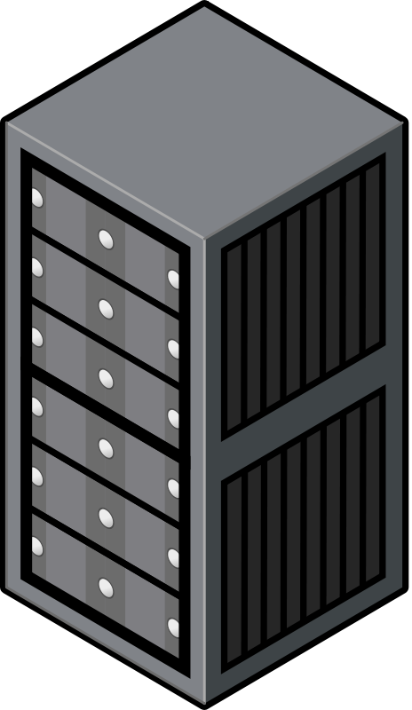
Lessons Learned from Batch
batch-2
batch-1
If a batch computation fails, simply repeat computation as a transaction
Transaction rate is constant
Can we apply these principles to a true streaming execution?
Notes:
Common thing is: a segment of the stream is going to run as a transaction. If it is not complete, we will have to revert to the last snapshot and replay the events.

Slide 23

Taking Snapshots – the naïve way
t1
t2
execution snapshots
Initial approach (e.g.,Naiad)
Pause execution on t1,t2,..
Collect state
Restore execution

Slide 24
Asynchronous Snapshots in Flink
t1
snapshotting
t2
snapshotting
Propagating markers/barriers
snap - t1
snap - t2
[Carbone et. al. 2015] “Lightweight Asynchronous Snapshots for Distributed Dataflows”, Tech. Report. http://arxiv.org/abs/1506.08603
Notes:
Builds on the idea of chandy lamport that you can take a snapshot wihtout having to stop the execution of the underlying program.

Slide 25
Batch vs. Streaming Analytics

Slide 26
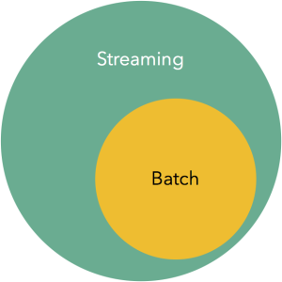
Batch is a Special Case of Streaming
Lower-overhead fault-tolerance via replaying intermediate results
Blocking operators (e.g., hybrid hash join) are embedded in streaming topology
map
join
sum
Notes:
One could wonder: can we use a streaming backend to perform batch processing? The answer is simple:
Parallel databases have used pipelined execution engines for ages. The answer is yes.
To do that you will need two ingredients: 1) blocking operations and 2) high throughput (than streaming engines).
The first ingredient is easy to find: batch processing jobs use blocking operators instead of streaming ones (e.g., a hybrid hash join).
The second ingredient is a bit more complex. Let me talk about data transfer in Flink.
Flink serializes tuples and puts them into buffers that are transferred through the network.
Buffers have two configurations that you can tweak: buffer size (bytes) and timeout (ms):
-> If the buffer size is large and its timeout (maximum time that a buffers can lie around waiting to be filled with records to arrive) is large as well, we attain high throughput but high latency.
> If the buffer is small and its timeout is small as well, we achieve lower throughput but lower latency as well.
But there’s another distinctive feature of Flink, that makes execution fast and robust: Managed memory.

Slide 27
e.g.: Non-native streaming (Spark, Hadoop, etc.)
stream
discretizer
while (true) {
// get next few records
// issue batch job
}
Job
Job
Job
Job

Slide 28
Closing

Slide 29
tl;dr: what was this about?
The case for Flink as a stream processor
Proper streaming engine foundation
Flexible Windowing
Fault Tolerance with exactly once guarantees
Integration with batch
Large (and growing!) community

Slide 31
Thank you

Slide 32
The road ahead
Parallel Data Analysis for non-geeks

Slide 33
Querying Databases ➤ Data Analysis
Tables ➤ Tables and unstructured files, matrices, logs, graphs
Multitude of data models
Queries (SQL) ➤ Programs (Java, SQL, R, Scala, Python, R, etc.)
Iterative processing, control flow, general object manipulation, user defined functions
Data Loading ➤ Files dumped in a (H)DFS
Schema on read
Proprietary ➤ Open source
Multitude of Systems

Slide 34
A (narrow) view of the Big Data Zoo
SQL
HiveQL
PigLatin
…
”Native” job (Java, Scala, C++…)
High Level Language Compiler
Get/Put Operations
Apache Flink
GraphLab
Apache Hadoop
Read/Write Bytes
Key/value Store
Hadoop Distributed File System (HDFS)
Cluster Management (Mesos, YARN, ZooKeeper…)

Slide 35
Database Mosaics
“Uber” Language
Matrix
Databag
?
Emma
Streams
Control-Flow
IR, Compiler, Optimizer
Runtime Multiple Execution Engines, Stores, and Hardware
Apache Flink
AsterixDB
Apache Spark
IBM DB2
ScaLapack
HDFS
Tachyon
Cassandra
HBase

Slide 36
Emma: Key Features
... // initialize points and clusters while (change > epsilon) {
val clusters = (for (p <- points) yield {
val c = ctrds.minBy(distanceTo(p)).get
Solution(c.id, p.p)
}).groupBy(_.cid)
// compute new centroids
val newCtrds = for (clr <- clusters) yield {
val sum = (for (p <- clr.values) yield p.pos).sum()
val cnt = (for (p <- clr.values) yield p.pos).cnt()
Point(c.key, sum / cnt)
}
// compute the total change in all centroids
change = {
val distances = for (
x <- ctrds;
y <- newCtrds; if x.id == y.id) yield dist(x, y)
distances.sum()
}
// use the new centroids in the next iteration
ctrds = newCtrds }
... // finalize result
Deeply Embedded in Scala
Relax! This is not a new language

Slide 37
Emma: Key Features
... // initialize points and clusters while (change > epsilon) {
val clusters = (for (p <- points) yield {
val c = ctrds.minBy(distanceTo(p)).get
Solution(c.id, p.p)
}).groupBy(_.cid)
// compute new centroids
val newCtrds = for (clr <- clusters) yield {
val sum = (for (p <- clr.values) yield p.pos).sum()
val cnt = (for (p <- clr.values) yield p.pos).cnt()
Point(c.key, sum / cnt)
}
// compute the total change in all centroids
change = {
val distances = for (
x <- ctrds;
y <- newCtrds; if x.id == y.id) yield dist(x, y)
distances.sum()
}
// use the new centroids in the next iteration
ctrds = newCtrds }
... // finalize result
Deeply Embedded in Scala
Relax! This is not a new language
Core type: DataBag
a.k.a RDD (Spark) / DataSet (Flink)
Based on union algebra & folds

Slide 38
Emma: Key Features
... // initialize points and clusters while (change > epsilon) {
val clusters = (for (p <- points) yield {
val c = ctrds.minBy(distanceTo(p)).get
Solution(c.id, p.p)
}).groupBy(_.cid)
// compute new centroids
val newCtrds = for (clr <- clusters) yield {
val sum = (for (p <- clr.values) yield p.pos).sum()
val cnt = (for (p <- clr.values) yield p.pos).cnt()
Point(c.key, sum / cnt)
}
// compute the total change in all centroids
change = {
val distances = for (
x <- ctrds;
y <- newCtrds; if x.id == y.id) yield dist(x, y)
distances.sum()
}
// use the new centroids in the next iteration
ctrds = newCtrds }
... // finalize result
Deeply Embedded in Scala
Relax! This is not a new language
Core type: DataBag
a.k.a RDD (Spark) / DataSet (Flink)
Based on union algebra & folds
Scala for-comprehensions
Instead of join, cross
Like Select-From-Where in SQL

Slide 39
Emma: Key Features
... // initialize points and clusters while (change > epsilon) {
val clusters = (for (p <- points) yield {
val c = ctrds.minBy(distanceTo(p)).get
Solution(c.id, p.p)
}).groupBy(_.cid)
// compute new centroids
val newCtrds = for (clr <- clusters) yield {
val sum = (for (p <- clr.values) yield p.pos).sum()
val cnt = (for (p <- clr.values) yield p.pos).cnt()
Point(c.key, sum / cnt)
}
// compute the total change in all centroids
change = {
val distances = for (
x <- ctrds;
y <- newCtrds; if x.id == y.id) yield dist(x, y)
distances.sum()
}
// use the new centroids in the next iteration
ctrds = newCtrds }
... // finalize result
Deeply Embedded in Scala
Relax! This is not a new language
Core type: DataBag
a.k.a RDD (Spark) / DataSet (Flink)
Based on union algebra & folds
Scala for-comprehensions
Instead of join, cross
Like Select-From-Where in SQL
Nesting
Group values of type DataBag
Ubiquitous abstraction for computation

Slide 40
Emma: Key Features
... // initialize points and clusters while (change > epsilon) {
val clusters = (for (p <- points) yield {
val c = ctrds.minBy(distanceTo(p)).get
Solution(c.id, p.p)
}).groupBy(_.cid)
// compute new centroids
val newCtrds = for (clr <- clusters) yield {
val sum = (for (p <- clr.values) yield p.pos).sum()
val cnt = (for (p <- clr.values) yield p.pos).cnt()
Point(c.key, sum / cnt)
}
// compute the total change in all centroids
change = {
val distances = for (
x <- ctrds;
y <- newCtrds; if x.id == y.id) yield dist(x, y)
distances.sum()
}
// use the new centroids in the next iteration
ctrds = newCtrds }
... // finalize result
Deeply Embedded in Scala
Relax! This is not a new language
Core type: DataBag
a.k.a. RDD (Spark) / DataSet (Flink)
Based on union algebra & folds
Scala for-comprehensions
Instead of join, cross
Like Select-From-Where in SQL
Nesting
Group values of type DataBag
Ubiquitous abstraction for computation
DataBag expressions as coarse-grained parallelism contracts
Top-level: mapped to a dataflow API
Everything else (mostly) untouched

Slide 41
Thank you
If you find this exciting,
get involved on Flink‘s mailing list
Subscribe to news@flink.apache.org,
follow flink.apache.org/blog, and
@ApacheFlink on Twitter
Want to try out Emma? Drop me an email:
asterios.katsifodimos@tu-berlin.de

Slide 42
Appendix

Slide 43
Iterative processing in Flink
Flink offers built-in iterations and delta iterations to execute ML and graph algorithms efficiently
map
ID1
join
ID2
sum
ID3

Slide 44
Exactly once approaches
Discretized streams – mini-batching (Spark Streaming)
Treat streaming as a series of small atomic computations
“Fast track” to fault tolerance, but does not separate business logic from recovery
MillWheel (Google Cloud Dataflow)
State update and derived events committed as atomic transaction to a high-throughput transactional store
Needs a very high-throughput transactional store ☺
Chandy-Lamport-inspired distributed snapshots (Flink)*
*[Carbone et. al. 2015] “Lightweight Asynchronous Snapshots for Distributed Dataflows”, Tech. Report. http://arxiv.org/abs/1506.08603
Notes:
What does Storm do?

Slide 45
Roadmap
Short-term (3-6 months)
Graduate DataStream API from beta
Fully managed window and user-defined state with pluggable backends
Table API for streams (towards StreamSQL)
Long-term (6+ months)
Highly available master
Dynamic scale in/out
FlinkML and Gelly for streams
Full batch + stream unification

Slide 46
Discretized streams
while (true) {
// get next X seconds of data
// compute next stream and state
}
input
stream
Unit of fault tolerance is
mini-batch
Job
Job
Job
state
logical result
stream

Slide 47
Problems of mini-batch
Latency
Each mini-batch schedules a new job, loads user libraries, establishes DB connections, etc
Programming model
Does not separate business logic from recovery – changing the mini-batch size changes query results
Power
Keeping and updating state across mini-batches only possible by immutable computations

Slide 48
Exactly once approaches
Discretized streams – mini-batching (Spark Streaming)
Treat streaming as a series of small atomic computations
“Fast track” to fault tolerance, but does not separate business logic from recovery
MillWheel (Google Cloud Dataflow)
State update and derived events committed as atomic transaction to a high-throughput transactional store
Needs a very high-throughput transactional store ☺
Chandy-Lamport-inspired distributed snapshots (Flink)*
*[Carbone et. al. 2015] “Lightweight Asynchronous Snapshots for Distributed Dataflows”, Tech. Report. http://arxiv.org/abs/1506.08603
Notes:
What does Storm do?

Slide 49
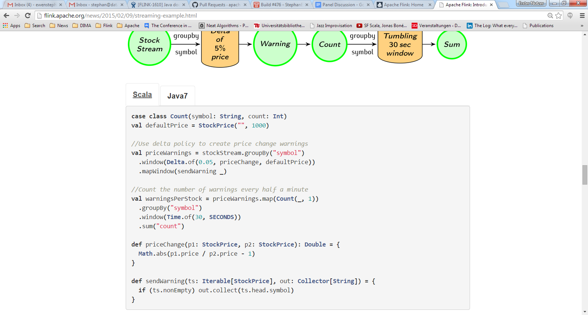
Windowing
More at: http://flink.apache.org/news/2015/02/09/streaming-example.html
Notes:
Delta of 5%: I want all consecutive tuples that have contributed to a 5% change of a given stock.
For those

Slide 50
Integration with batch
Currently cannot mix DataSet & DataStream programs
However, DataStream programs can read batch sources, they are just finite streams ☺
Goal is to evolve DataStream to a batch/stream-agnostic API
DataSet (Java/Scala/Python)
DataStream (Java/Scala)
Streaming dataflow runtime

Slide 51

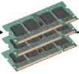
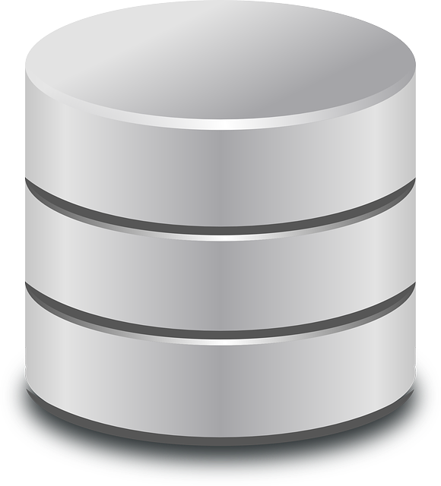
e.g.: Non-native iterations
for (int i = 0; i < maxIterations; i++) {
// Execute MapReduce job
}
Client
Step
Step
Step
Step
Step

Slide 52
What is Operator State?
User-defined state
Objects in Flink long running operators (map/reduce/etc)
Windowing operators
Time, count, data-driven, etc. window discretizers
Fault tolerance mechanism:
Back up and restored state stored in a backend (HDFS, Ignite, Cassandra, …)
After restore: replay stream from the last checkpoint

Slide 53
Why streaming
Data availability
Streaming
- Which data?
- When?
- Who?
- Some schema
- Ingestion rate
- Programmable
Batch
- Some schema
- Load rate
- Programmable
Data
Warehouse
- Strict schema
- Load rate
- BI access
2000
2008
2015

Slide 54
What does streaming enable?
1. Data integration
2. Low latency applications
Fresh recommendations, fraud detection, etc
Internet of Things, intelligent manufacturing
Results “right here, right now”
cf. Kleppmann: "Turning the DB inside out with Samza"
3. Batch < Streaming

Slide 55
The Stack
Table API
Storm
Dataflow
Gelly (Graph)
SAMOA
Table API (SQL)
ML
Zeppelin
Hadoop M/R
Dataflow
DataSet (Java/Scala)
DataStream (Java/Scala)
Streaming dataflow runtime
Native
Tez
Local
Cluster
Yarn

Slide 56
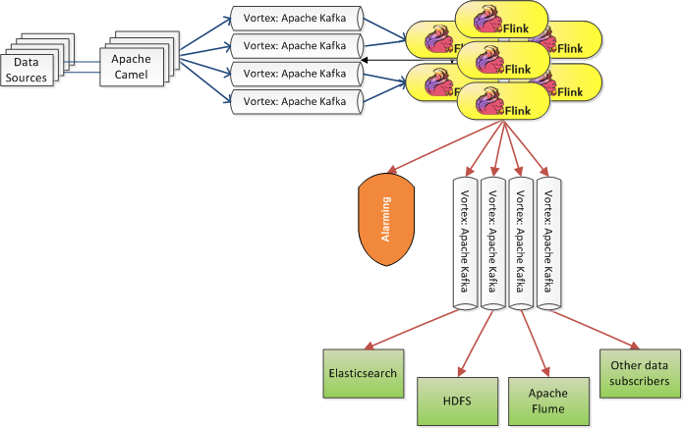

Example: Bouygues Telecom

Slide 57
Flink Optimizer
replace
Co-locate DISTINCT + JOIN
Iterate
Iterate
Forward
HDFS
Hybrid Hash Join
Group Reduce (Sorted (on [0]))
new Paths
Join
Union
Distinct
Hash Partition on [1]
Co-locate JOIN + UNION
Hash Partition on [1]
Step function
paths
Hash Partition on [0]
Loop-invariant data cached in memory
What you write is not what is executed
No need to hardcode execution strategies
Flink Optimizer decides:
Pipelines and dam/barrier placement
Sort- vs. hash- based execution
Data exchange (partition vs. broadcast)
Data partitioning steps
In-memory caching

Slide 58
Cost-based optimizer

Slide 59
What is a stream processor?
Pipelining
Stream replay
Operator state
Backup and restore
High-level APIs
Integration with batch
High availability
Scale-in and scale-out
Basics
State
App development
Large deployments

Slide 60
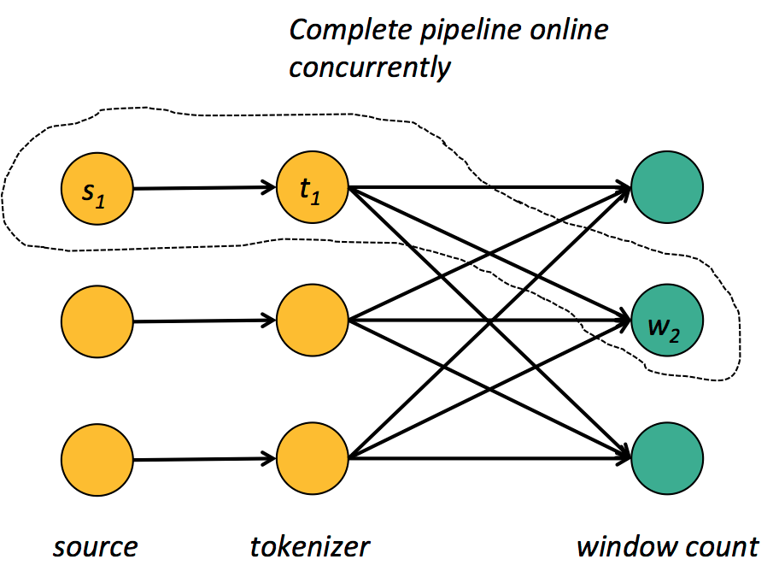
Pipelining
Basic building block to “keep the data moving”
Note: pipelined systems do not usually transfer individual tuples, but buffers that batch several tuples!

Slide 61


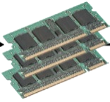

Built-in vs. driver-based looping
Loop outside the system, in driver program
Iterative program looks like many independent jobs
Client
Step
Step
Step
Step
Step
Client
Step
Step
Step
Step
Step
iter.
Dataflows with feedback edges
System is iteration-aware, can optimize the job
red.
map
join
Flink
join

Slide 62
Rich set of operators
Map, Reduce, Join, CoGroup, Union, Iterate, Delta Iterate, Filter, FlatMap, GroupReduce, Project, Aggregate, Distinct, Vertex-Update, Accumulators, …
Iterate
Source
Map
Reduce
Join
Reduce
Sink
Source
Map

Slide 63
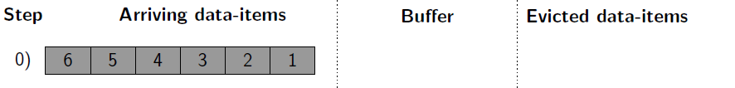
Stream Discretization Policies
Streams are represented as
FIFO-Queue of data-items
The window operator keeps a FIFO-Buffer
After some time, data-items expire (they are deleted)

Slide 64
Stream Discretization Policies
The window operator is event driven by
data-item arrival

Slide 65
Stream Discretization Policies
The window operator is event driven by
data-item arrivals
1.) Trigger Policies (TPs)
Specify when the aggregate is executed on the current buffer content.
Define the moment that results are emitted.
2.) Eviction Policies (EPs) Specify when data-items are removed from the buffer.
Defines the size of a window.

Slide 66
Stream Discretization Policies
Query Example (tumbling/fixed window of size 3):
dataStream.window(Count.of(3))
1.) Trigger Policies (TPs)
Specify when the aggregate is executed on the current buffer content.
Define the moment that results are emitted.
2.) Eviction Policies (EPs) Specify when data-items are removed from the buffer.
Defines the size of a window.

Slide 67
Stream Discretization Policies
1.) Trigger Policies (TPs)
Specify when the aggregate is executed on the current buffer content.
Define the moment that results are emitted.
2.) Eviction Policies (EPs) Specify when data-items are removed from the buffer.
Defines the size of a window.

Slide 68
Stream Discretization Policies
1.) Trigger Policies (TPs)
Specify when the aggregate is executed on the current buffer content.
Define the moment that results are emitted.
2.) Eviction Policies (EPs) Specify when data-items are removed from the buffer.
Defines the size of a window.

Slide 69
Stream Discretization Policies
1.) Trigger Policies (TPs)
Specify when the aggregate is executed on the current buffer content.
Define the moment that results are emitted.
2.) Eviction Policies (EPs) Specify when data-items are removed from the buffer.
Defines the size of a window.
Notes:
Fix this line

Slide 70
Stream Discretization Policies
1.) Trigger Policies (TPs)
Specify when the aggregate is executed on the current buffer content.
Define the moment that results are emitted.
2.) Eviction Policies (EPs) Specify when data-items are removed from the buffer.
Defines the size of a window.

Slide 71
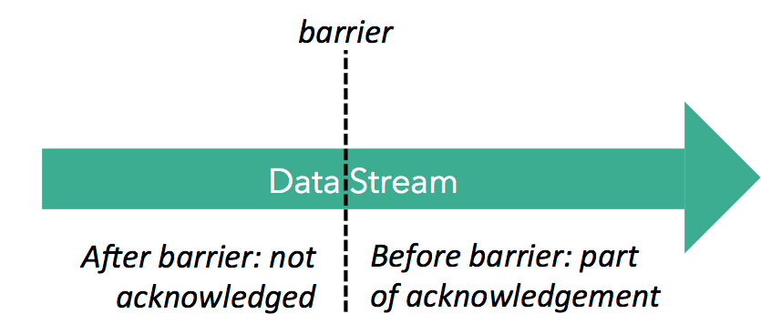
Distributed snapshots in Flink
Super-impose checkpointing mechanism on execution instead of using execution as the checkpointing mechanism

Slide 72
JobManager
Register checkpoint
barrier on master
Replay will start from here

Slide 73
JobManager
Barriers “push” prior events (assumes in-order delivery in individual channels)
Operator checkpointing starting
Operator checkpointing in progress
Operator checkpointing finished

Slide 74
Pluggable mechanism. Currently either JobManager (for small state) or file system (HDFS/Tachyon).
JobManager
Operator checkpointing takes snapshot of state after data prior to barrier have updated the state.
State backup

Slide 75
JobManager
State backup
State snapshots at sinks signal successful end of this checkpoint
At failure, recover last checkpointed state and restart sources from last barrier guarantees at least once

Slide 76
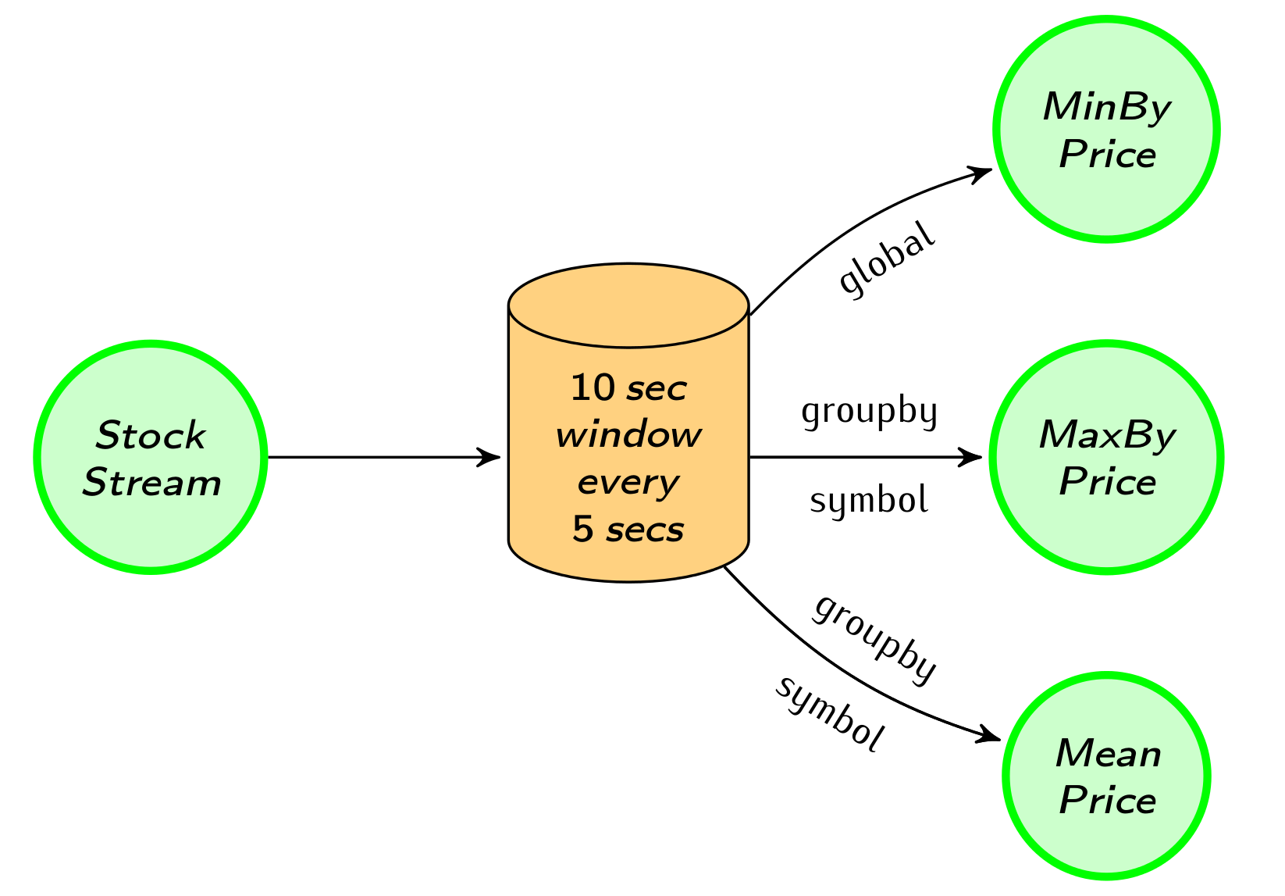
Example Analysis: Windowed Aggregation
StockPrice(HDP, 23.8)
(2)
StockPrice(SPX, 2113.9)
StockPrice(FTSE, 6931.7)
StockPrice(HDP, 23.8)
StockPrice(HDP, 26.6)
(1)
StockPrice(SPX, 2113.9)
StockPrice(FTSE, 6931.7)
StockPrice(HDP, 26.6)
(3)
StockPrice(SPX, 2113.9)
StockPrice(FTSE, 6931.7)
StockPrice(HDP, 25.2)
(4)
(1)
val windowedStream = stockStream.window(Time.of(10, SECONDS)).every(Time.of(5, SECONDS))
val lowest = windowedStream.minBy("price")
val maxByStock = windowedStream.groupBy("symbol").maxBy("price")
val rollingMean = windowedStream.groupBy("symbol").mapWindow(mean _)
(2)
(3)
(4)
Notes:
Mean is an example of an aggregation that needs the full view of the window while min/max can be done in an optimized fashion (e.g., with a combiner and even within the window buffer)

Slide 77
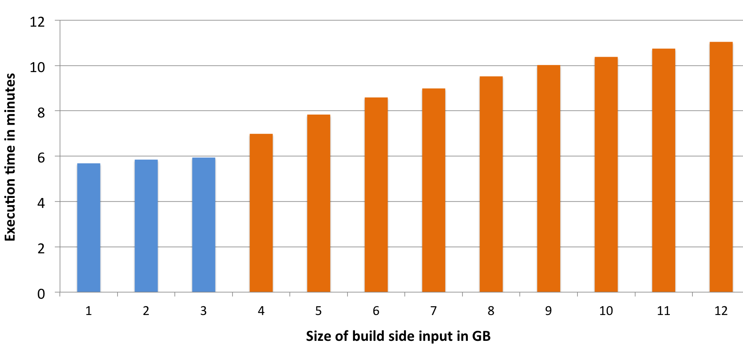
Managed Memory
Language APIs automatically converts objects to tuples
Tuples mapped to pages of bytes
Operators work on pages
Full control over memory, out-of-core enabled
Operators (e.g., Hybrid Hash Join) address individual fields (not deserialize whole object)
Memory runs out
Notes:
Here we see the execution time of a flink’s hybrid hash join when operating with a large build side:
On the X axis, we increase the size of the build side, until it doesn’t fit in memory.
Then (in orange) we see how the performance is degrading, since the hash table is partly residing in Disk.
It is very important to see here that the execution of the join is very robust, this is due to the use of managed memory.

Slide 78


Quiz: guess the algorithm!
... // initialize
while (theta) {
newCntrds = points
.map(findNearestCntrd)
.map( (c, p) => (c, (p, 1L)) )
.reduceByKey( (x, y) =>
(x._1 + y._1, x._2 + y._2) )
.map( x => Centroid(x._1, x._2._1 / x._2._2) )
bcCntrs = sc.broadcast(newCntrds.collect())
}
... // initialize
val cntrds = centroids.iterate(theta) { currCntrds =>
val newCntrds = points
.map(findNearestCntrd).withBcSet(currCntrds, "cntrds")
.map( (c, p) => (c, p, 1L) )
.groupBy(0).reduce( (x, y) =>
(x._1, x._2 + y._2, x._3 + y._3) )
.map( x => Centroid(x._1, x._2 / x._3) )
currCntrds
}

Slide 79

Problem Statement
Runtime-centric evolution of the APIs results in
Too much low-level aspects exposed
Hard to teach people how and when to use them
Affects productivity
Neglects optimization potential
We are hard-coding execution plans!
Back in the 70s? Can we do better?
Notes:
First was map-reduce, then combiners (pre-aggregations), then

Slide 80

Compilers to the Rescue!
Deep language embedding
A holistic view of the complete data analysis enables
Parallelism transparency (SPJ + nesting)
Advanced Optimizations
Notes:
What is deep language embedding?

Slide 81
Sneak peak: Two of Flink’s APIs
case class Word (word: String, frequency: Int)
DataSet API (batch):
val lines: DataSet[String] = env.readTextFile(...)
lines.flatMap {line => line.split(" ")
.map(word => Word(word,1))}
.groupBy("word").sum("frequency")
.print()
DataStream API (streaming):
val lines: DataStream[String] = env.fromSocketStream(...)
lines.flatMap {line => line.split(" ")
.map(word => Word(word,1))}
.keyBy("word")
.trigger(Time.of(5,SECONDS)). .evictor(Time.of(1,SECONDS))
.sum("frequency”)
.print()
Notes:
What we see here is how we can express programs in Scala. On the topmost part you see a class, containing a Workd string and an integer for the word frequency.
In Flink classes like this one can be used as records: they are flattened and then serialized by the execution engine when needed.
Note here that we can refer to the field of a class with its name: this is something that Flink’s compiler does under the hood.
Sliding window of 5 seconds, triggered every second.

Slide 82
Benefits of Flink’s approach
Data processing does not block
Can checkpoint at any interval you like to balance overhead/recovery time
Separates business logic from recovery
Checkpointing interval is a config parameter, not a variable in the program (as in discretization)
Can support richer windows
Session windows, event time, etc.
Best of all worlds: true streaming latency, exactly-once semantics, and low overhead for recovery

